Slide 1


Pre-service Middle School Science Teachers Practice Leading Discussions with Virtual Avatars
Daniel M. Levin, Dana L. Grosser-Clarkson, Natalia Galvez Molina, Amman A. Haque, Elizabeth E. Fleming, and Alexander K. Chumbley

Slide 2

Video example of a Pre-service teacher

Slide 3
Use model
PSTs approximate practice of leading discussion about natural phenomena and responding to avatars’ thinking (Example: What causes grass to smell when it’s freshly cut?)
Intended to provide practice in attending and responding to ideas and reason in a safe setting (“kayaking in calm waters”; Grossman et al., 2009)
Prior course activities include pedagogies of PBTE (McDonald et al., 2013) in this and related practices

Slide 4
Simulation Instructions to Mursion
What causes the grass to smell when it’s freshly cut?
Background
Avatars have been studying plants. They have been taught different parts of the plant. They also previously studied animals and animal adaptations.
Exemplar Responses
When grass is cut, it gives off chemicals that can travel into the air and to our noses. Some of these chemicals promote wound healing and others act like antibiotics. Some other plants also give off toxic compounds when cut.
Anticipations. The avatars might:
Recognize the possibility that chemicals or some other substances are being released. Although they may not see that this has some sort of function.
Some might think it functions as a defense mechanism, but others might ask why it doesn’t hurt cows.
Avatars might say it comes from “juices” inside the grass.
Some may simply say that the plant is being disturbed.
Some might say that the smell is due to a chemical coming out of the lawnmower.
Someone might mention that it can stain their shoes green.
Some might argue that the smell is coming from the ground, not the grass.
Some might notice that it smells sometimes after a rain and think it has something to do with water.
Someone might say it’s just the smell from “inside the grass”.
Someone might think the smell is to attract other species that might come to prey on something that is attacking the grass.

Slide 5
Components of the Use Model
Modeling, Representing, and Decomposing Practice
Interview
Avatar
Anticipating
Lesson Planning with Discussion, Anticipating
Avatars!
Analysis
Other Course Activities

Slide 6
Theory of Action
Teacher learning as situated and interactional (Russ, Sherin, & Sherin, 2015)
High-leverage (core) practices of teaching (Grossman, et al., 2009; teachingworks.org)
Practice-based teacher education (McDonald, et al., 2013)
Leading discussion (Ball & Forzani, 2009; Duschl & Gitomer, 1997)
Connected to practices of eliciting and responding, undergirded by attention to students’ thinking (Levin et al., 2009; Neel, 2015; Robertson et al., 2016; Sherin, Jacobs, & Philipp, 2011)
Focus on scientific practices of constructing and critiquing explanations for phenomena (Ford, 2010; NGSS, 2013)

Slide 7
Research Questions
In what ways were PSTs similar and different in eliciting and responding to avatar student thinking? (whole class patterns)
In what ways were PSTs’ goals for the discussion connected to their practices? (cases of individual PSTs)

Slide 8
Methods
Data Sources
  Field notes, video recordings, transcripts of each session (RQ1)
  PSTs’ written analysis of discussions (RQ2)
Data Analysis (RQ1)
  Deductive codes (Miles, Huberman, & Soldana, 2013) derived from Pierson’s (2008) study of responsiveness among secondary mathematics teachers
    Responsiveness (L, M, HI, HII)
    Intellectual Demand (IGL, IGH, IDL, IDH)
  Coded each meaningful, content relevant response (responsiveness and ID code)
  Two authors coded 8 of 26 transcripts chosen randomly to calculate inter-rater reliability.
  Agreement was 79%, and rose to 85% for HII/IDH codes, which made up 40% of all codes
  Highlighted row(s) or column(s) capturing at least 50% of codes to characterize profiles (Fleming, Grosser-Clarkson, & Levin, 2018)

Slide 9
Methods cont’d
Data Analysis (RQ2)
  Analyzed three PSTs discussions in more depth
  Inductive and interpretive (Maxwell, 2013)
  Conducted interaction analysis (Jordan & Henderson, 2005)
  Watch segments together, discussing PSTs’ responsive practice and apparent goals
  Triangulated our interpretations with PSTs’ expressed goals in their analysis

Slide 10
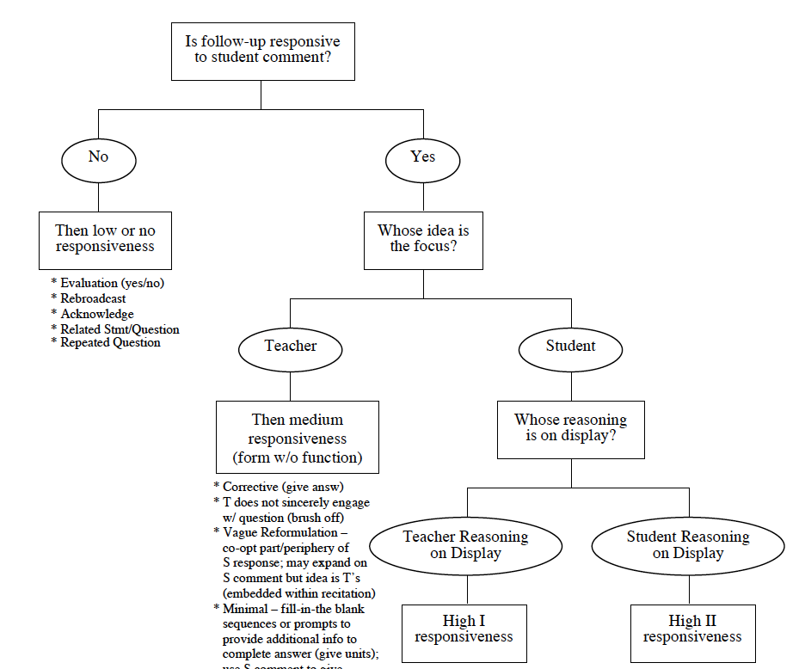
Methods: Responsiveness (Pierson, 2008)
Low
M
HI
HII

Slide 11
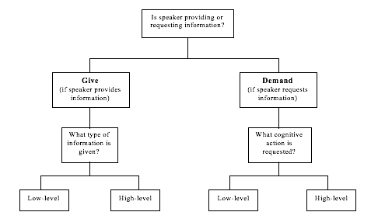
Methods: Intellectual Work (Pierson, 2008)
IGL
IGH
IDL
IDH

Slide 12
Learnings (RQ1)
Student | First Avatar | Profile | Second Avatar | Profile
[“Alexa”] | Grass | HII/IDH | Snow | HII/IDH
“An” | Snow | L | Rainbows | IDL
“Arlene” | Rainbows | HII/IDH | Grass | HII/IDH
“Courtnee” | Snow | HII/IDH | Rainbows | HII/IDH
“Dean” | Snow | L/IDL | Leaves | L
“Evan” | Snow | L | Leaves | IDH
“Kelly” | Grass | IDH | Leaves | HII/IDH
“James” | Snow | IDL | Leaves | HII/IDH
[“Matt”] | Grass | -- | Rainbows | IDL
[“Nina”] | Grass | HII/IDH | Rainbows | HII/IDH
“Nomi” | Snow | HII | Leaves | HII/IDH
“Sabine” | Snow | L/IDL | Rainbows | L/IDL
“Sharon” | Rainbows | -- | Leaves | IDH
Fraction RL |  | 4/13 |  | 2/13
Fraction IDL |  | 3/13 |  | 3/13
Fraction HII |  | 6/13 |  | 7/13
Fraction IDH |  | 5/13 |  | 9/13
Fraction HII/IDH |  | 4/13 |  | 6/13
Questions
What causes the grass to smell when it’s freshly cut?
What causes it to snow?
What causes rainbows?
What causes leaves to change color?
Whole class data
(Three selected PST names are bracketed and lines bolded)

Slide 13
Learnings (RQ1) cont’d
Alexa (Grass) | Low/No | Medium | High I | High II
Give Low | 0 | 0 | 0 | 0
Give High | 0 | 0 | 1 | 0
Demand Low | 1 | 0 | 0 | 0
Demand High | 4 | 0 | 3 | 14
Matt (Rainbows) | Low/No | Medium | High I | High II
Give Low | 0 | 2 | 0 | 0
Give High | 0 | 0 | 0 | 1
Demand Low | 8 | 7 | 7 | 0
Demand High | 0 | 0 | 0 | 11
Tina (Grass) | Low/No | Medium | High I | High II
Give Low | 0 | 1 | 4 | 0
Give High | 0 | 0 | 0 | 2
Demand Low | 6 | 5 | 0 | 0
Demand High | 0 | 2 | 3 | 24

Slide 14
Learnings (RQ2)
Alexa
Alternating probing and guiding (HII --> HI)
“Agree or disagree?”: pressing for consensus
“Most of my facilitation was focused on the goal of getting students to respond to each other’s thinking and to really listen to what they are saying”
Matt
Difficulty launching question
Tendency to “choose” particular ideas or insert his own (HI --> HII)
Consistent with stated goal of “identifying entities (factors)”
Tina
“Soft launch”, (e.g.,“Who has seen a rainbow? When/where do you see it?”)
Progression toward drawing on student ideas to collaboratively construct an explanation
“Comfortable to share” (e.g., Tang, 2010); consistent with stated goals

Slide 15
Learnings (Summary)
It’s possible to distinguish broad profiles of responsiveness
Many PSTs can respond to student ideas while facilitating construction and critique of explanations for phenomena
Few “Give” codes likely reflects “Being told not to tell” (Chazan & Ball, 1999)
PSTs’ practice is aligned with their observed (inferred) and stated goals

Slide 16
Implications and Future Directions
The approximation not only supports PSTs’ practice but also serves as a valuable assessment to inform classroom supervision
What accounts for differences among PSTs' responsiveness? Goals? Beliefs? Anxiety?
Develop “instructional goals” profiles (Mikeska, personal communication)
Ongoing research into case study participants’ responsive practice in student teaching and beyond (Levin et al., 2019)

