Slide 1
Rehearsals of Teaching: A Simulation of Complex Practice
Hala Ghousseini
University of Wisconsin-Madison
&
The Learning In, From, and For Practice Project
Simulations in Teacher Education Conference, Louisville, KY
Feb 19-21, 2019

Slide 2

Learning in, from, and for teaching practice
Rethinking the design of teacher education
Magdalene Lampert, Hala Ghousseini, Heather Beasley, Megan Franke, Angela Chan Turrou, Elham Kazemi, Adrian Cunard
University of Michigan
University of Washington
University of Wisconsin
University of California, Los Angeles

Slide 3
Cycles of Enactment and Investigation
next cycle
1 – OBSERVATION
6 – COLLECTIVE ANALYSIS
SAME INSTRUCTIONAL ACTIVITY
ACROSS SETTINGS
2 – COLLECTIVE ANALYSIS
Math Content, Practices, & Principles
5 – CLASSROOM ENACTMENT
3 – PREPARATION
4 – REHEARSAL

Slide 4
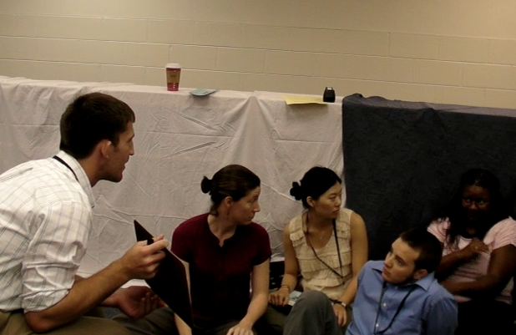
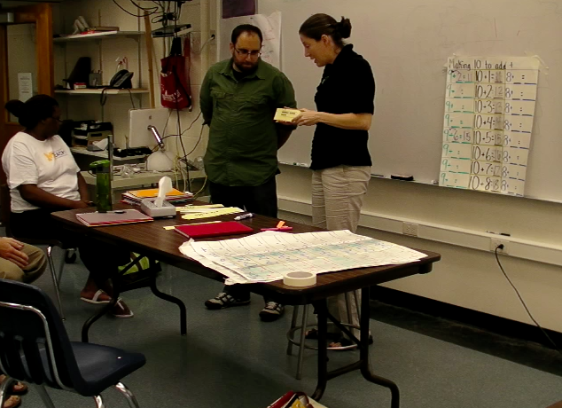
Rehearsals of Teaching
Novices engage in (both) simulating and analyzing manageable chunks of interactive teaching before enacting them with students in classrooms
Involve more than one novice teacher (NT) and a teacher educator (TE)
  One NT (or more) participates as teacher; others participate as students
  TE acts both as coach and simulated student
Not scripted; involve improvised performance and authentic complexities
Involve several pauses to allow for analysis & feedback
Involve deliberate practice and incremental improvement of performance (Lampert et al., 2013)

Slide 5
Rehearsals are shaped by many factors
Who the novice teachers are and where they are in their learning to teach
The novices’ experience with an instructional activity
The culture that is promoted and maintained for making one’s practice public
By how close they are to enactments in actual classrooms

Slide 6
Theory of Action
Deliberate Practice involves carefully sequenced structured (practice) experiences aimed at developing targeted skills, with the aim of incrementally improving performance in response to knowledge of results, feedback (or both) from a teacher/coach.
(Ericsson, Krampe, & Tesch-Romer, 1993)
Adaptive Performance: The back and forth between experience and reflection on enactments of a skill and resulting consequences (Hatano & Inagaki, 1986) builds an iterative and interactive relationship between knowledge and principles on the one hand, and practical tools or skills on the other.

Slide 7
Deliberate Practice Inside Rehearsal
Professional knowledge and commitments
related to ambitious teaching
Adaptive performance: knowing not only a skill but also the conceptual underpinning that guides its use
Instructional Practice(s)
Instructor (and others)
Problem of practice
+
Objectives
of Activity
Teacher

Slide 8
Deliberate Practice through the Cycle
next cycle
1 – OBSERVATION
6 – COLLECTIVE ANALYSIS
2 – COLLECTIVE ANALYSIS
SAME INSTRUCTIONAL ACTIVITY
ACROSS SETTINGS
5 – CLASSROOM
ENACTMENT
Math content
Practices Principles
3 – PREPARATION
4 – REHEARSAL

