Slide 1

Authentic, Effective, Real Time Interactions in Simulation
Kate Ingraham (University of Central Florida) Morgan Russell (Mursion)

Slide 2
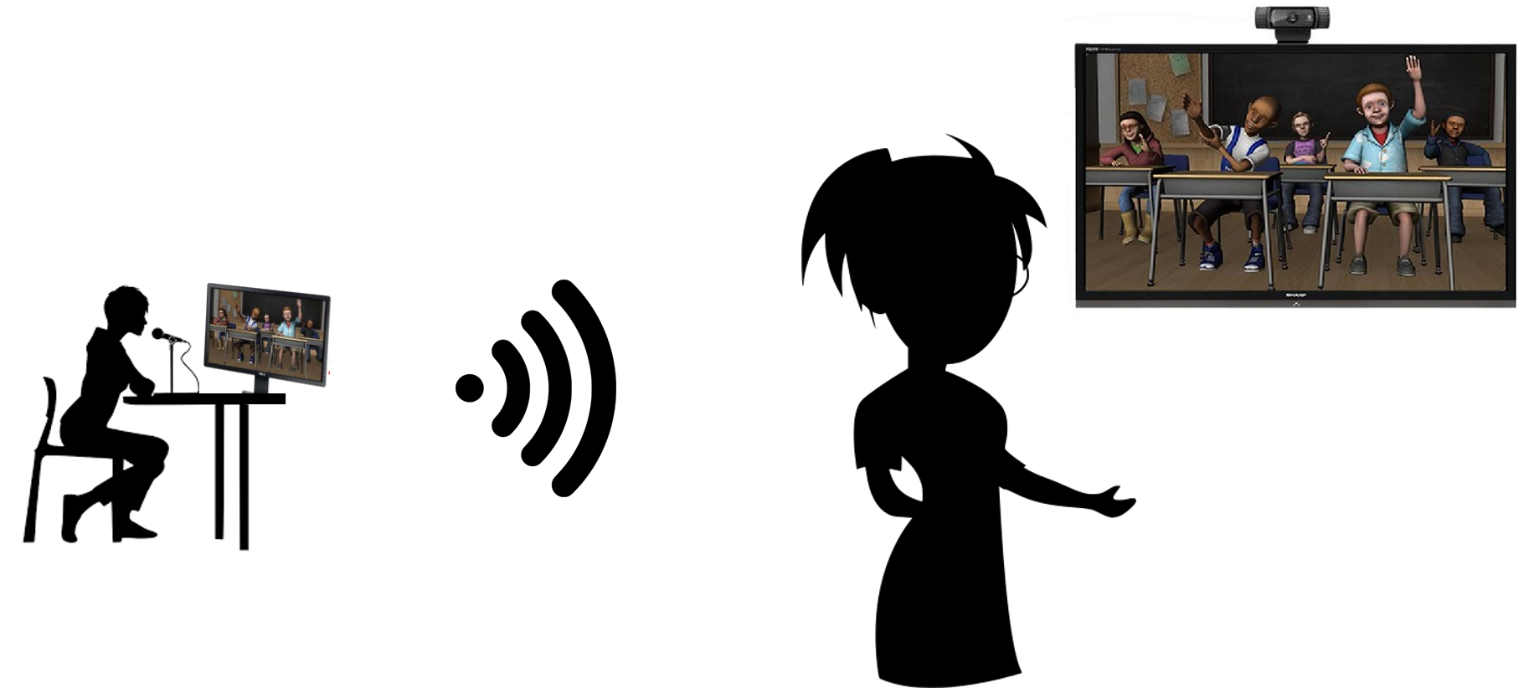
Overview of TeachLivE / Mursion Platform

Slide 3
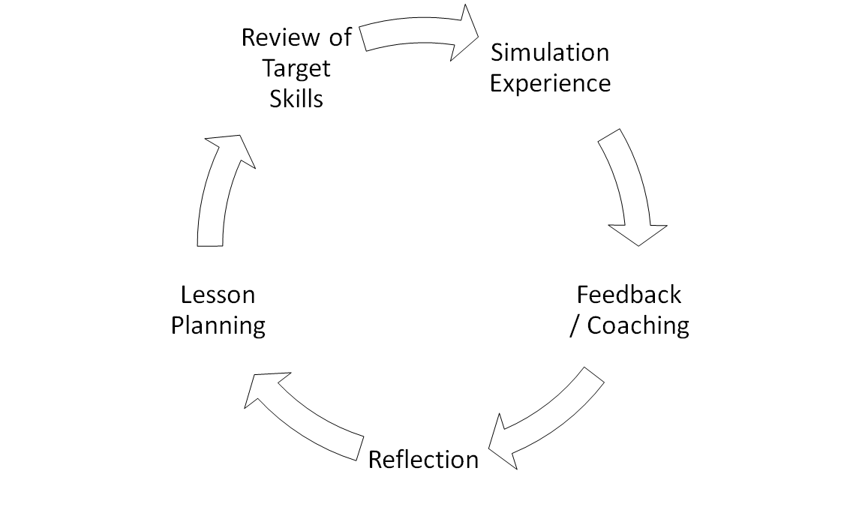
Learning Theory / Feedback Cycle

Slide 4
Scenario Design Theory and Process
Alignment is Key.
Defined Skills Simulation Challenges Feedback

Slide 5
Implementation
Design
  System
  Avatars and environments
  Training materials
Delivery
  Ongoing interactive performance excellence

Slide 6
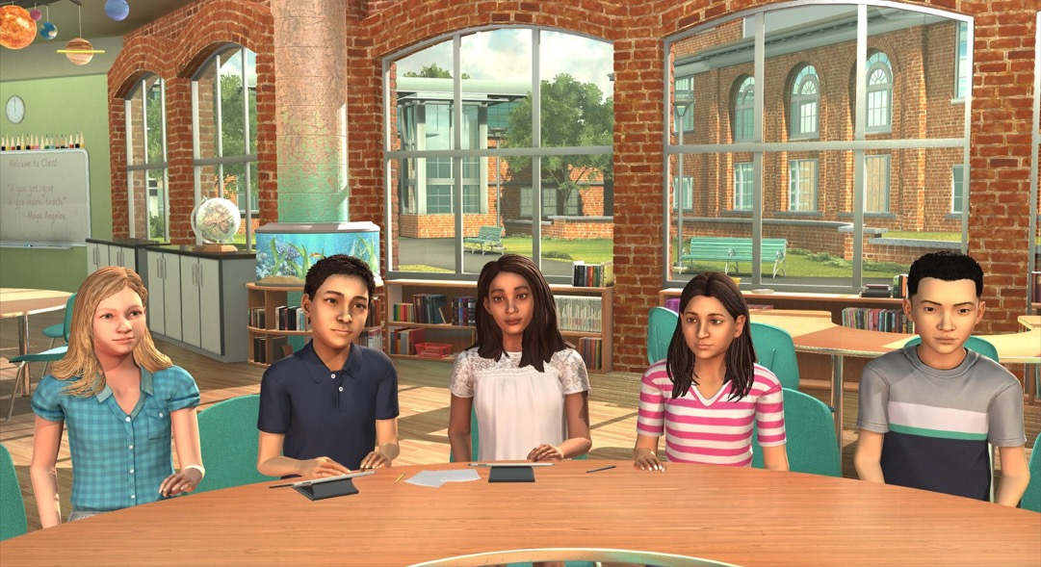
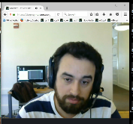
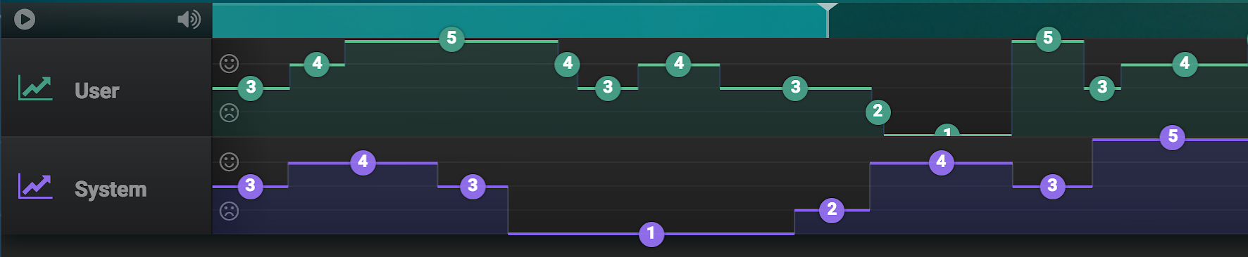
Future Potential Analytics
FOR LEARNER REVIEW AFTER SIMULATION
Turn taking
Engagement
Articulation rate/fluency
Listening
Discreetly measurable objectives
Influence
Rapport Building
Emotional Prosody

Slide 7
Plicker Questions

Slide 8
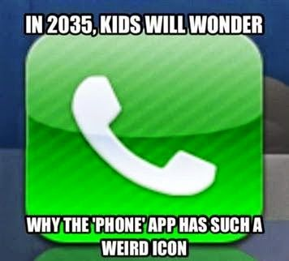
Ending Joke

